Slide 1
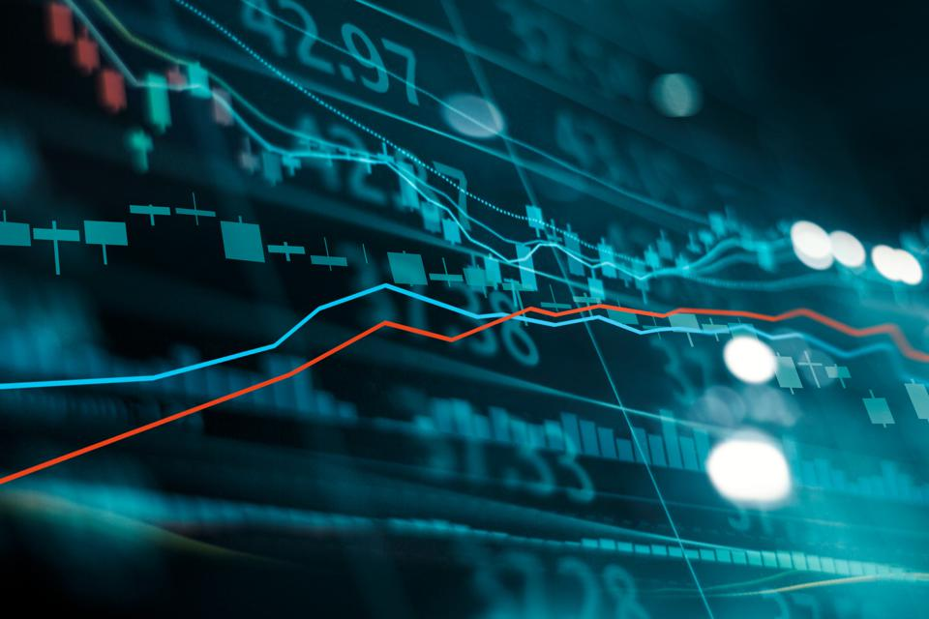
Wealth-Rock

Slide 2
ESG Analysis: Evaluates the environmental, social, and governance aspects of potential investments. If we get more than a 70% score, it indicates a good investment.
Technical Analysis: Employs statistical measures and historical price trends to predict future performance. Key indicators include RSI, MACD, and simple moving averages.
Macro Indices: Considers macroeconomic factors such as inflation rates, GDP growth, and employment statistics. We particularly focus on GDP growth.
Sentiment Analysis: Analyzes market sentiment and investor behavior using natural language processing techniques. We generate mock news to gauge the market sentiment.

Slide 3
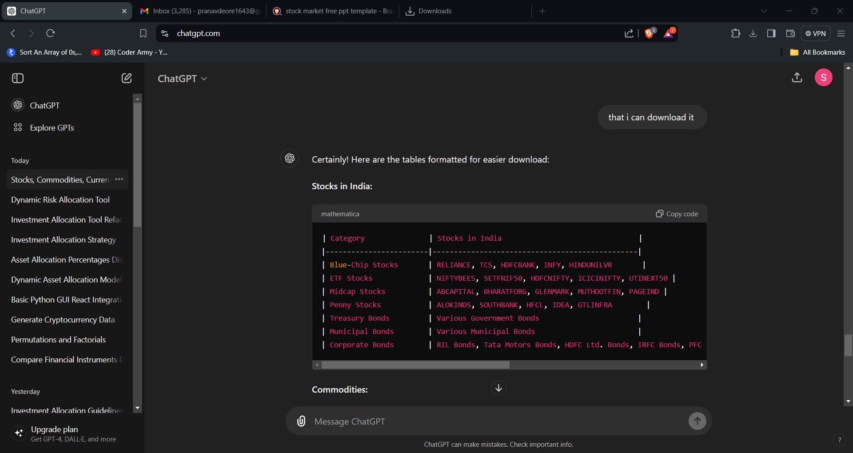
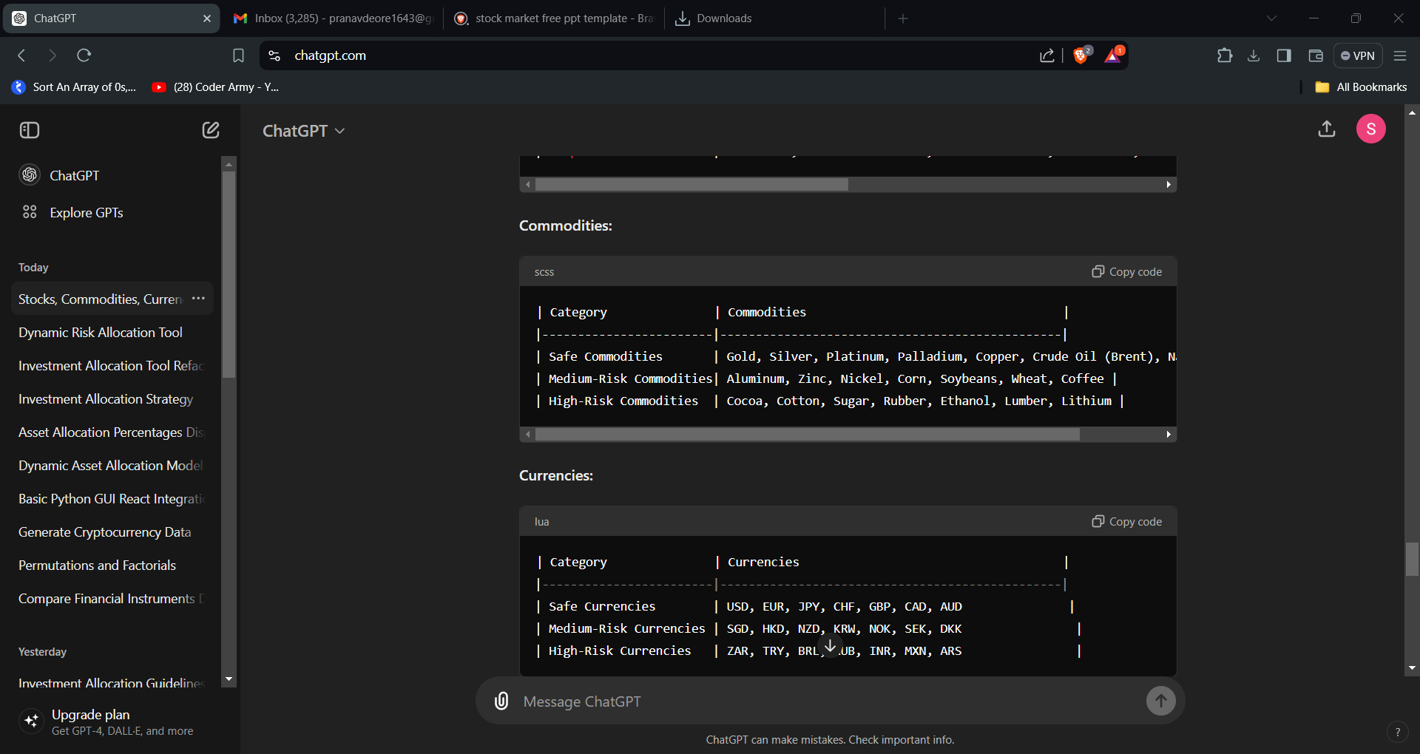
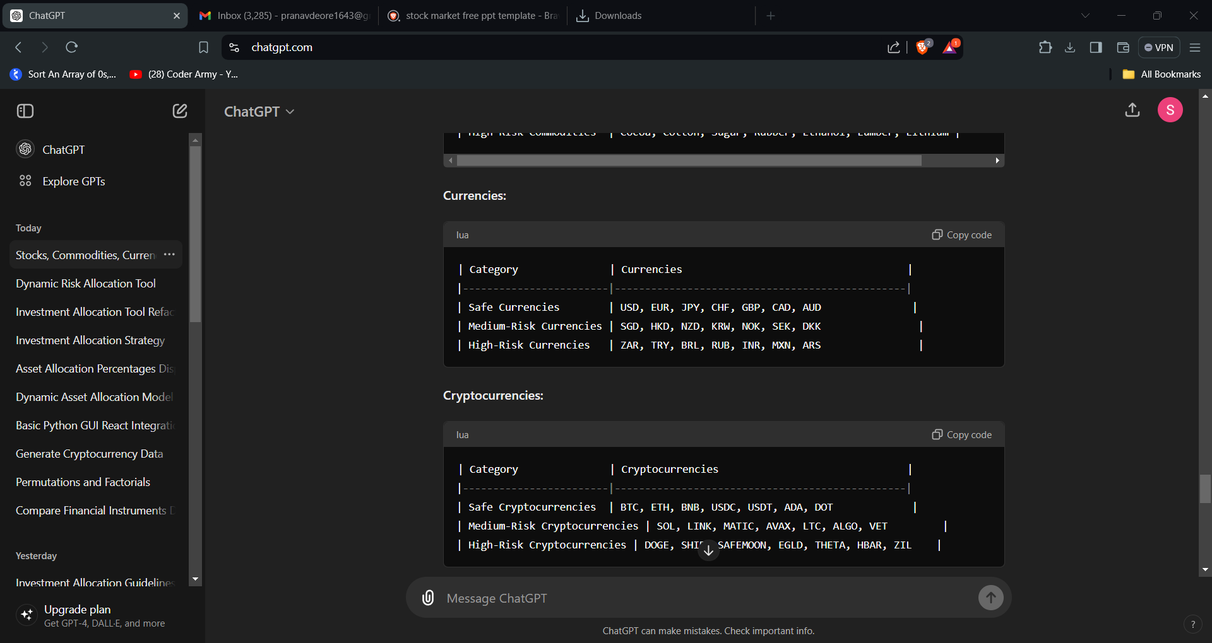
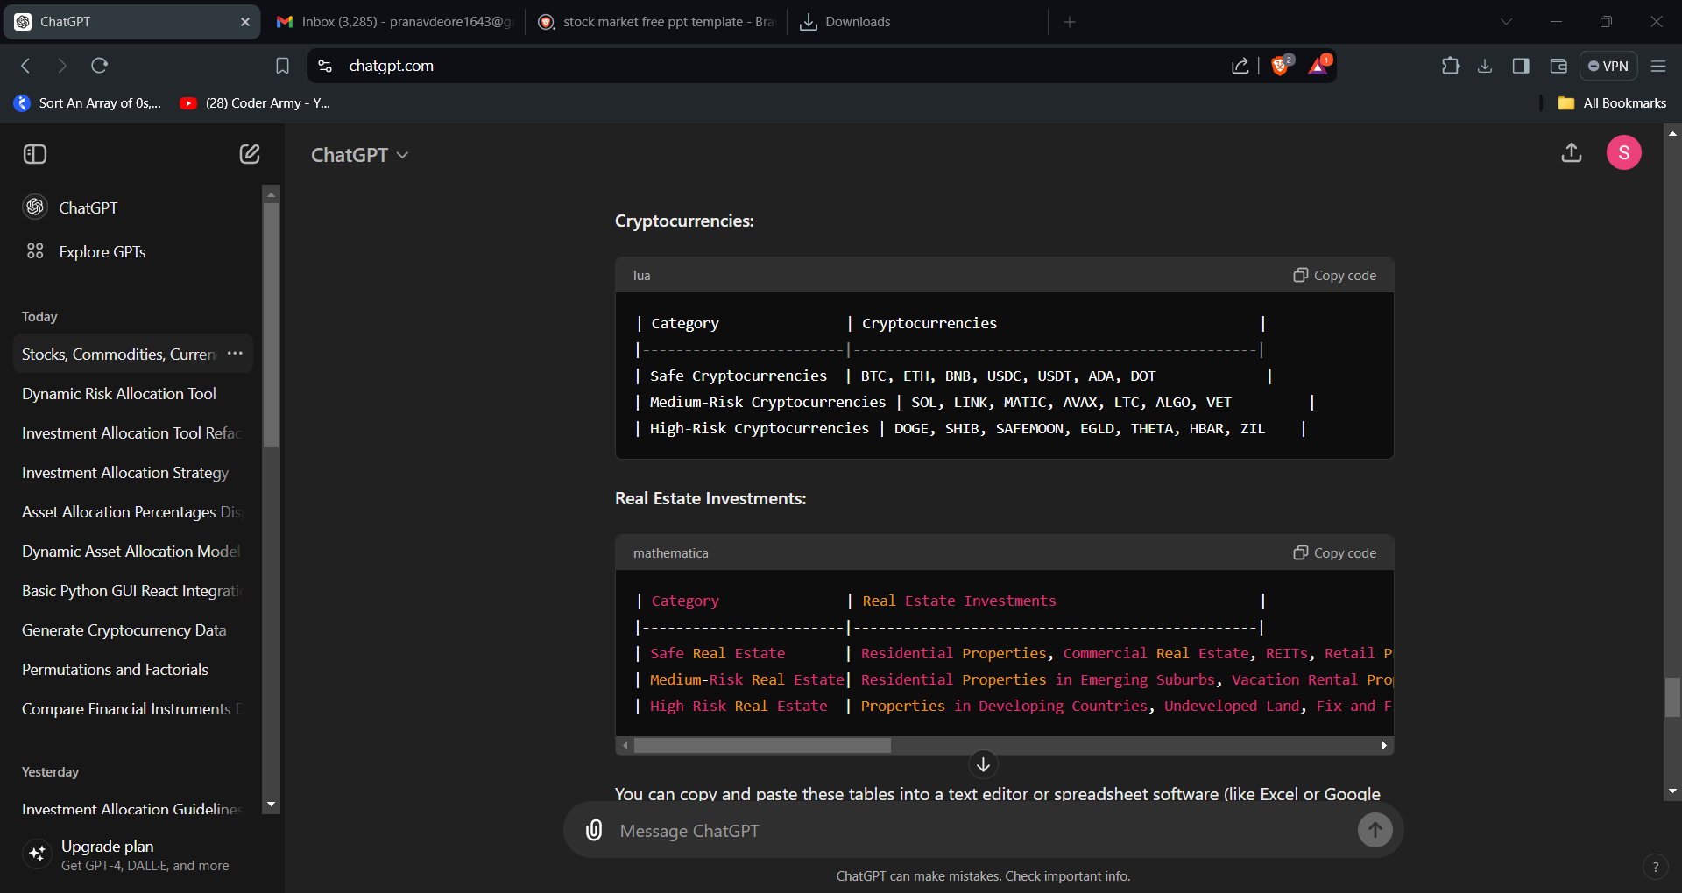
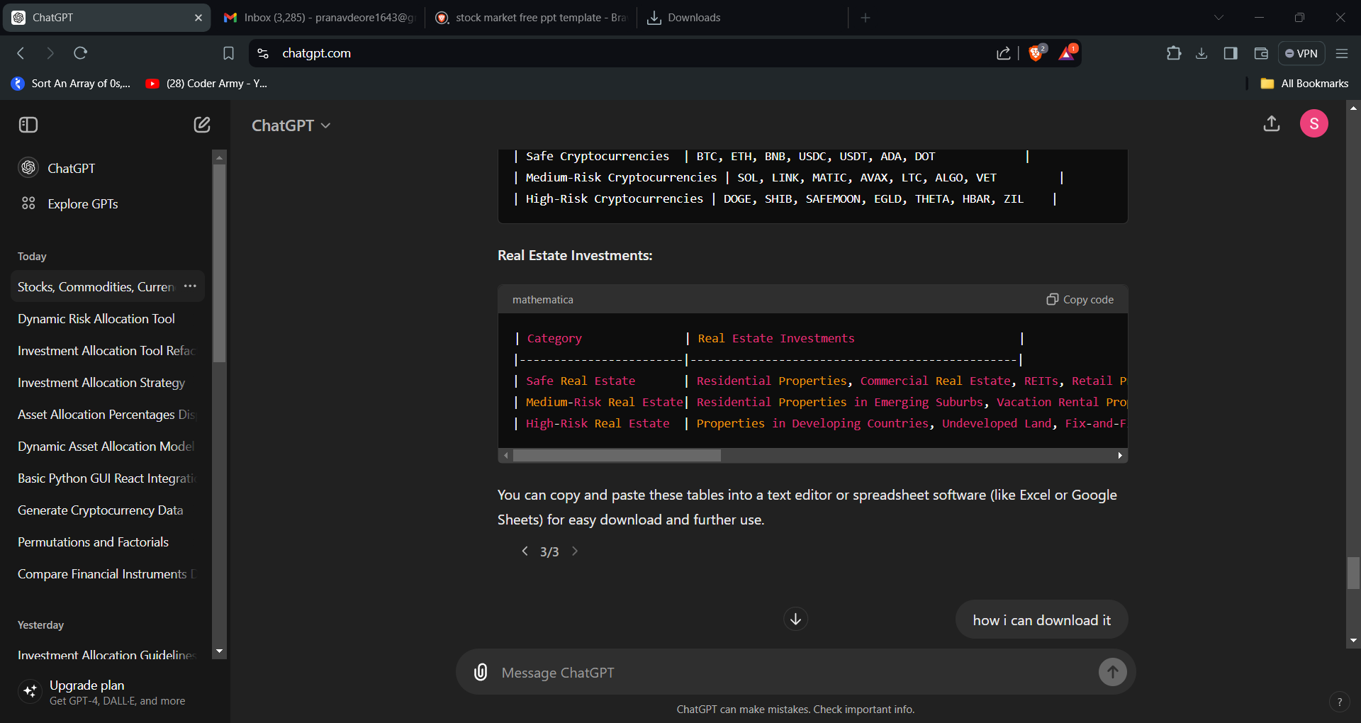
Section-A
Section-B
Section-C

Slide 4
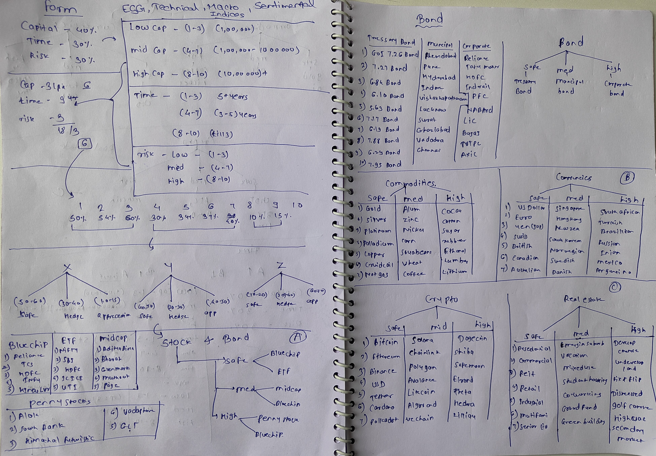

Slide 5

Capital
Getting Mean
Time
Risk
Depend on our ESG Analysis,Technical Analysis,Macro Indices,Sentiment Analysis.
Positive
Negative

Slide 6
1 2 3 4 5 6 7 8 9 10
50 – 60%
30 – 40%
10 – 15%
X
Y
Z
Safe
Safe
Hedge
HigRisk
Safe
Safe
Hedge
HighRisk
Safe
Safe
Hedge
HigRisk
Hedge
HigRisk
Hedge
HighRisk
Hedge
HighRisk
50 – 60%
50 – 60%
50 – 60%
30 – 40%
50 – 60%
50 – 60%
10 – 20%
30 – 40%
50 – 60%
50 – 60%
50 – 60%
20 – 40%
50 – 60%
10 – 20%
30 – 40%
50 – 60%
30 – 40%
40 – 60%

Slide 7
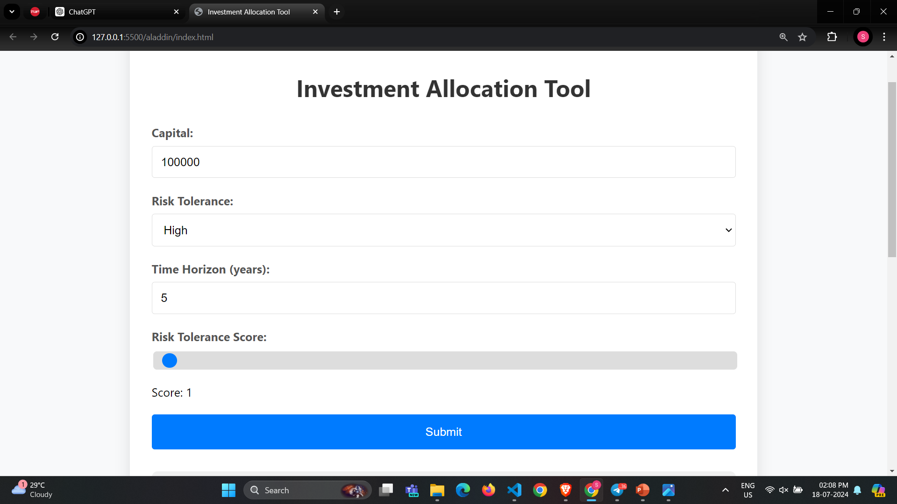

Slide 8
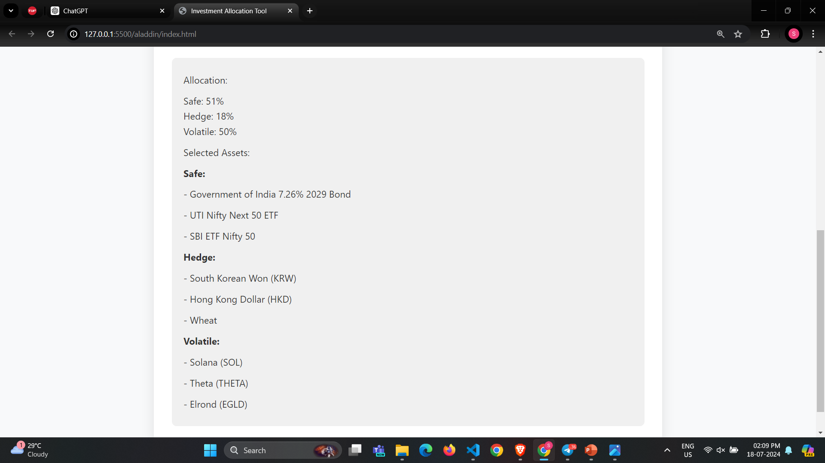

Slide 9
Thank You

